Slide 1
Multiplication of Signed Numbers
CSE 430 – Assignment 4

Slide 2
Problem Statement
For this assignment you will need to implement the control logic for multiplication of signed numbers using sequence register and decoder method. We will be using 5 bit sign-magnitude form for this. Meaning 1 bit sign and 4 bit magnitude.
In this slide we will be going step by step of what we need to do to implement this control logic

Slide 3
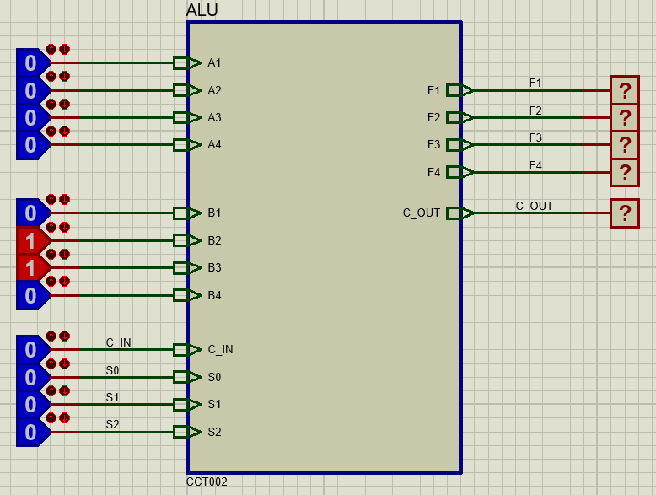
Step 1: ALU Sub-circuit
First we need design the sub-circuit of our basic ALU. Use your previously designed ALU here.

Slide 4
Step 2: Accumulator Sub-circuit
We don’t need our accumulator to implement many functions here. We just need it to load the output from ALU or hold it’s current value. For this we will be using a universal shift register (74194).
The shift register operates as follows-
S₁S₀ = 00 → Hold value
S₁S₀ = 10 → Shift right (MSB in SL)
S₁S₀ = 11 → Parallel Load
MR = 0 → Reset
Similar to the ALU we check if it can load and value as expected.
Once you have checked that, connect the ALU’s output to the accumulators input, and the accumulators output to the A input of ALU. Now check the components together.

Slide 5
Step 3: Implement Multiplier register Q
It will be the same as the accumulator. Except we will need provision to load an initial value

Slide 6
Step 4: Implement Counter
We will need to control the number of iterations depending on the number of bits, 4 in this case. In this case we will not count down from 4 to 0 like the algorithm suggests. It will be easier for us to count up from 0 to 4 and terminate after 4 count.
Use a 74193 to implement the counter

Slide 7
Step 5: Implement Transition logic
Implement the state transition logic using JK flip flops and a decoder.

Slide 8
Step 6: Implement the control signals
Implement the control signals as the functions of the states.
Check the values with logicprobes when you are done.

Slide 9
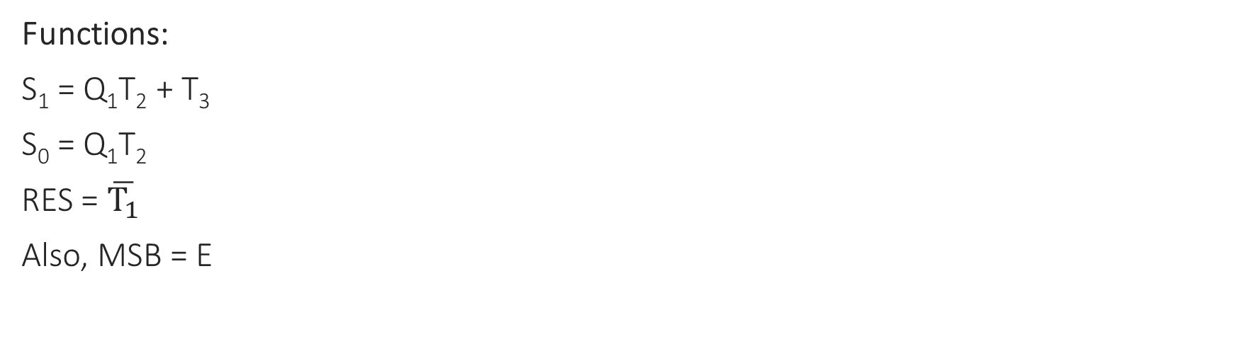
Control signals of A:
State | S₁ | S₀ | RES
T₁ | 0 | 0 | 0
Q₁T₂ | 1 | 1 | 1
T₃ | 1 | 0 | 1
Functions:
S₁ = Q₁T₂ + T₃
S₀ = Q₁T₂
RES = $\overline{T_{1}}$
Also, MSB = E

Slide 10
Control signals of Q:
State | S₁ | S₀
T₁ | 1 | 1
T₃ | 1 | 0
Functions:
S₁ = T₁ + T₃
S₀ = T₁
Also, RES = 1
and MSB = A₁

Slide 11

Control signals of Counter:
Functions:
D₃ – D₀ = 0100 (4)
DN = T₂.CLK
PL = $\overline{T_{1}}$
MR = 0
Output:
P_{z} = TCD’

Slide 12
Step 7: Implement A_{s} and E
Use E (like previous assignment)
Implement A_{s} = B_{s} xor Q_{s}

Slide 13
Control signals of E:
State | J_{E} | K_{E}
T₁ | 0 | 1
Q₁T₂ | C_{out} | C_{out}’
T₃ | 0 | 1
Functions:
J_{E} = Q₁T₂C_{out}
K_{E} = T₁ + T₃ + Q₁T₂C_{out}’

Slide 14

Final Step:
You are good to go now, check the design for all possible scenarios in $\left(±B\right) ×(±Q)$

Slide 15
Deadline
Section B: 02/09
Submit your Proteus files in ELMS.

